Slide 1
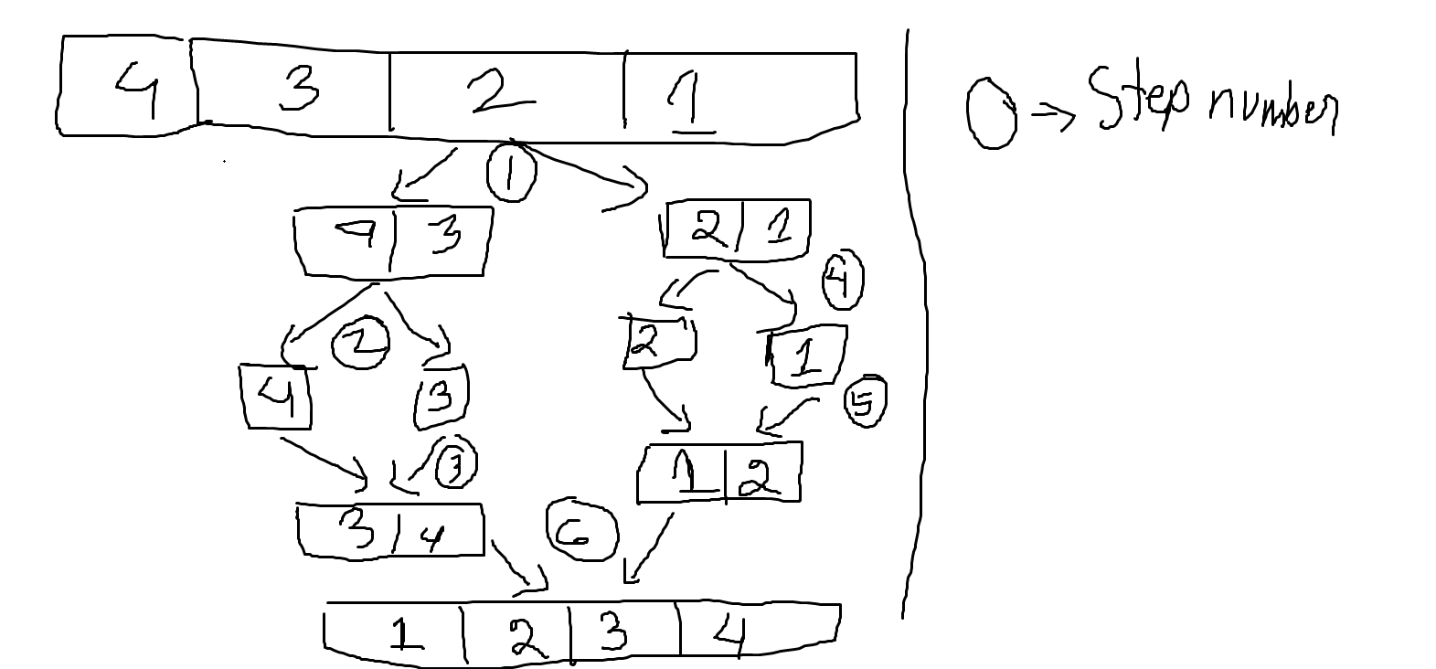
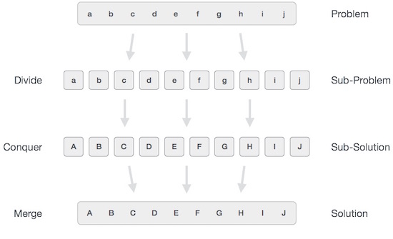
Merge sort is an example of Divide and conquer.
I will divide the main problem into subproblems and then divide the subproblems into smaller subproblems and like this find out the smallest subproblem I can find. Then find the smallest sub solutions of the smallest subproblems. Then accumulate all the subsolutions to find out the final solution.

Slide 2
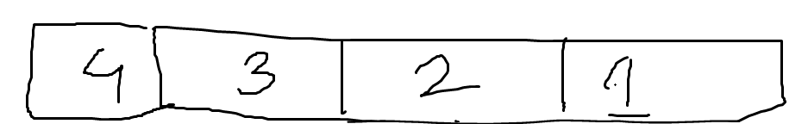
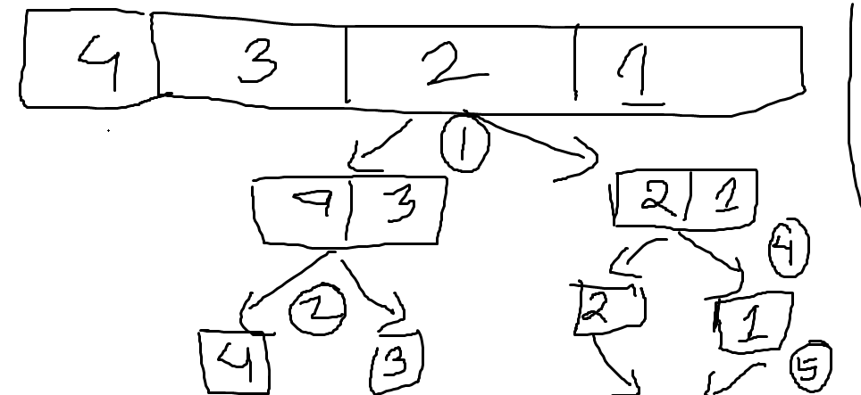
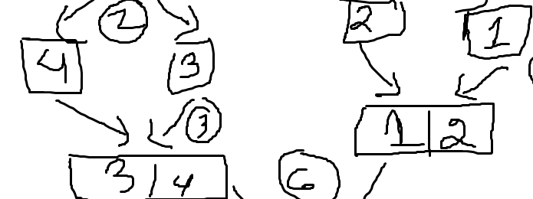
Step 1: send the list to a function called divideList
Step 2: Keep calling the divideList function until its impossible
Step 3: start solving the smallest subproblems

Slide 3
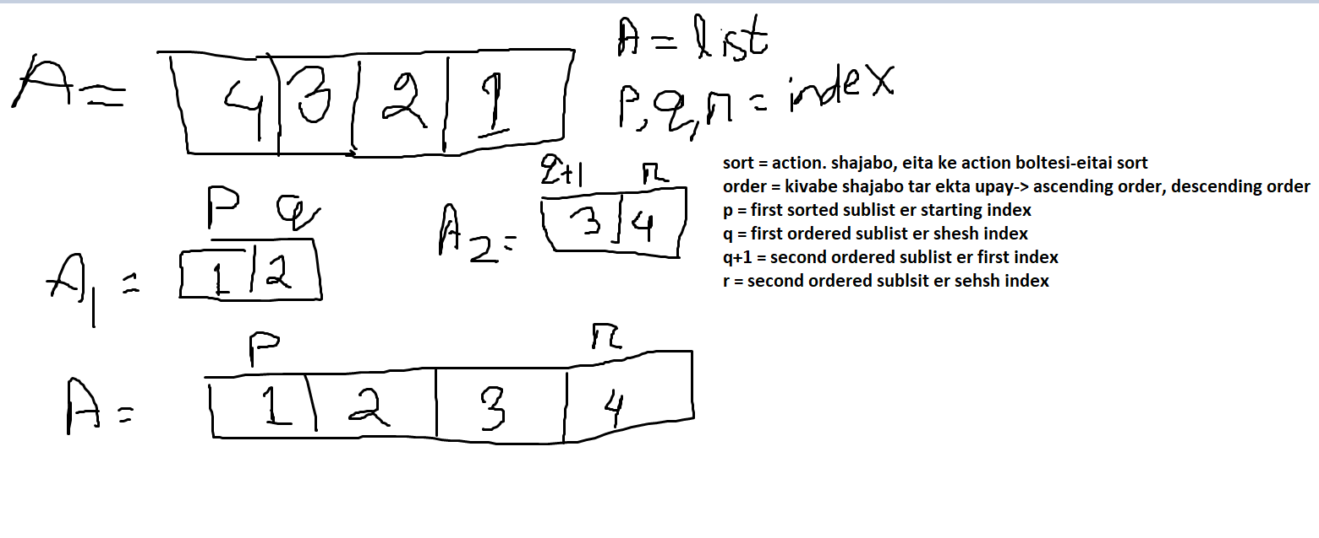

Slide 4
p
q
q+1/o
r
A
3
15
2
10
19
Function merge:
Input: A as list, p q r as integer
Return: sorted list
A[p,q] and A[q+1,r] is already sorted
Method:
q+1 ke o dhorbo
sortedList
A[p,q] and A[o,r] sorted
Jotokkhon na p>q othoba o>r hoy:
jodi A[p] <= A[o} hoy:
sortedList e append A[p]
p++
othoba:
sortedList e append A[o]
o++
jodi p>q hoy:
A[o,r] er sob element er jonno:
sortedList e append element
14. Jodi o>r hoy:
A[o,r] er sob element er jonno:
sorted list e sob element append
return sortedList

Slide 5
p
q+1/o
q
r
Mergesort function input
A
5
3
6
Mergesort function return
p
q
q+1
r
A
5
5
3
6
3
6
A
A = [5,3,6]
N = len(A)
dividedArray1 = mergeSort(A,p,q where p = N/2)
=> dividedArray1 = [5]
dividedArray2 = mergeSort(A,q+1,r)
=>dividedArray2 = [3,6]
Return merge(A,p,q,r)
=> Return [3,5,6]
p
q
q+1
r
3
3
A
6
6
A

Slide 6
p
q
q+1/o
r
Mergesort function input
A
5
7
18
6
3
Mergesort function return
p
q
q+1
r
A
5
7
5
7
1
6
11
1
6
11
A
5
5
7
7
1
1
6
11
6
11
A = [5,7,1,6,11]
N = len(A)
dividedArray1 = mergeSort(A,p,q where p = N/2)
=> dividedArray1 = [5,7]
dividedArray2 = mergeSort(A,q+1,r)
=>dividedArray2 = [1,6,11]
Return merge(A,p,q,r)
=> Return [1,5,6,7,11]
A
6
6
11
11

